Slide 1

Simple
internet usage monitoring
Notes:
Introducing Fastvue Reporter, internet usage monitoring and reporting made simple. Customers no longer need to rely on vendor-supplied firewall reporting tools, or overly complex SIEM and log analysis tools to understand what their users are doing on the internet. Fastvue Reporter allows organisations to monitor and understand internet usage and thereby shape acceptable usage policies and protect their investment in network infrastructure and employees/students.
During this presentation we will introduce you to Fastvue Reporter and how it will benefit your customers and your security portfolio.
Let’s start by looking at the key use cases for Fastvue Reporter and internet usage reporting.

Slide 2


Fastvue for Business
Send scheduled reports to Department Managers and HR detailing their staff’s Internet usage.
Notes:
In most business environments, internet usage reporting is a requirement to ensure staff are using the internet productively, and aren’t putting the network at unnecessary risk. We’re also seeing a growing trend where organisations are increasingly concerned about employee wellbeing and would like to address issues of workplace harassment and mental health issues in a proactive way.
Requests often come from management and HR staff to the IT department for detailed (and understandable) reports on how staff are using the internet. IT Staff are often time-poor and also don’t want to be involved in policing usage or spying on their colleagues. Giving them a simple to use tool to create the reports being requested, and confidence that the reports will be accurate and easy to understand is the key aim of Fastvue Reporter.

Slide 3


Fastvue for Education
Safeguard students by monitoring access to self-harm, extremist, or inappropriate content.
Notes:
Education facilities (both schools and tertiary) have a duty of care to monitor how their users are accessing the internet. While some usage may be putting the network at risk, the primary interest we see from most schools is around monitoring student well-being and proactive action relating to “at-risk” students and staff.
Vendor-supplied firewall reporting tools are (sometimes) suitable for reporting on technical performance aspects of the firewall. But they are not useful in providing readable reports, and customisable real-time alerts on the sort of information that Pastoral Care/Well-being/Safeguarding/Student-services staff are concerned with.

Slide 4

Fastvue for
IT
Easily discover the firewall features and policies responsible for allowing or blocking specific traffic.
Notes:
While Fastvue Reporter’s primary function is to provide simple and easy to understand internet usage reporting for non-technical users, it is also a powerful tool for configuring and troubleshooting firewall and network performance issues.
Getting insight into why certain traffic is being blocked (or allowed) can be challenging in vendor-supplied reporting tools.

Slide 5

Real-time
alerts
Would you know if a user searches for “easiest way to kill myself”?
Sending alerts on any traffic, such as online searches for keywords, visits to unacceptable content or extended time on unproductive sites.
Notes:
Using Fastvue Reporter, the answer to the question above is a confident “yes”. Not only can you customise what events trigger alerts, but Fastvue Reporter also allows you to choose who receives the alert. This ensures that the most appropriate people receive the information they need, in real-time.
Real-time alerting is critical in education, but is becoming increasingly popular in corporate networks these days.

Slide 6

Internet usage reports
Can you easily send internet usage reports to non-technical people?
Sending simple reports to non-technical audiences such as HR, Department Managers, School Principals, Teachers, Pastoral care, or employees themselves.
Notes:
Have you tried running an internet usage report on your own browsing recently, using a vendor-supplied reporting tool?
How well did it reflect what sites you actually visited?
Can your IT staff create such reports and confidently send them to non-technical readers who are requesting these reports?
Fastvue Reporter is designed to make this not just possible, but also easy.

Slide 7
Simple
Internet Usage Monitoring?
Notes:
You’ve probably heard me use the term simple (or easy) internet usage monitoring throughout the presentation so far. What do we actually mean by that phrase?
Let’s take a look at a real-world example.

Slide 8
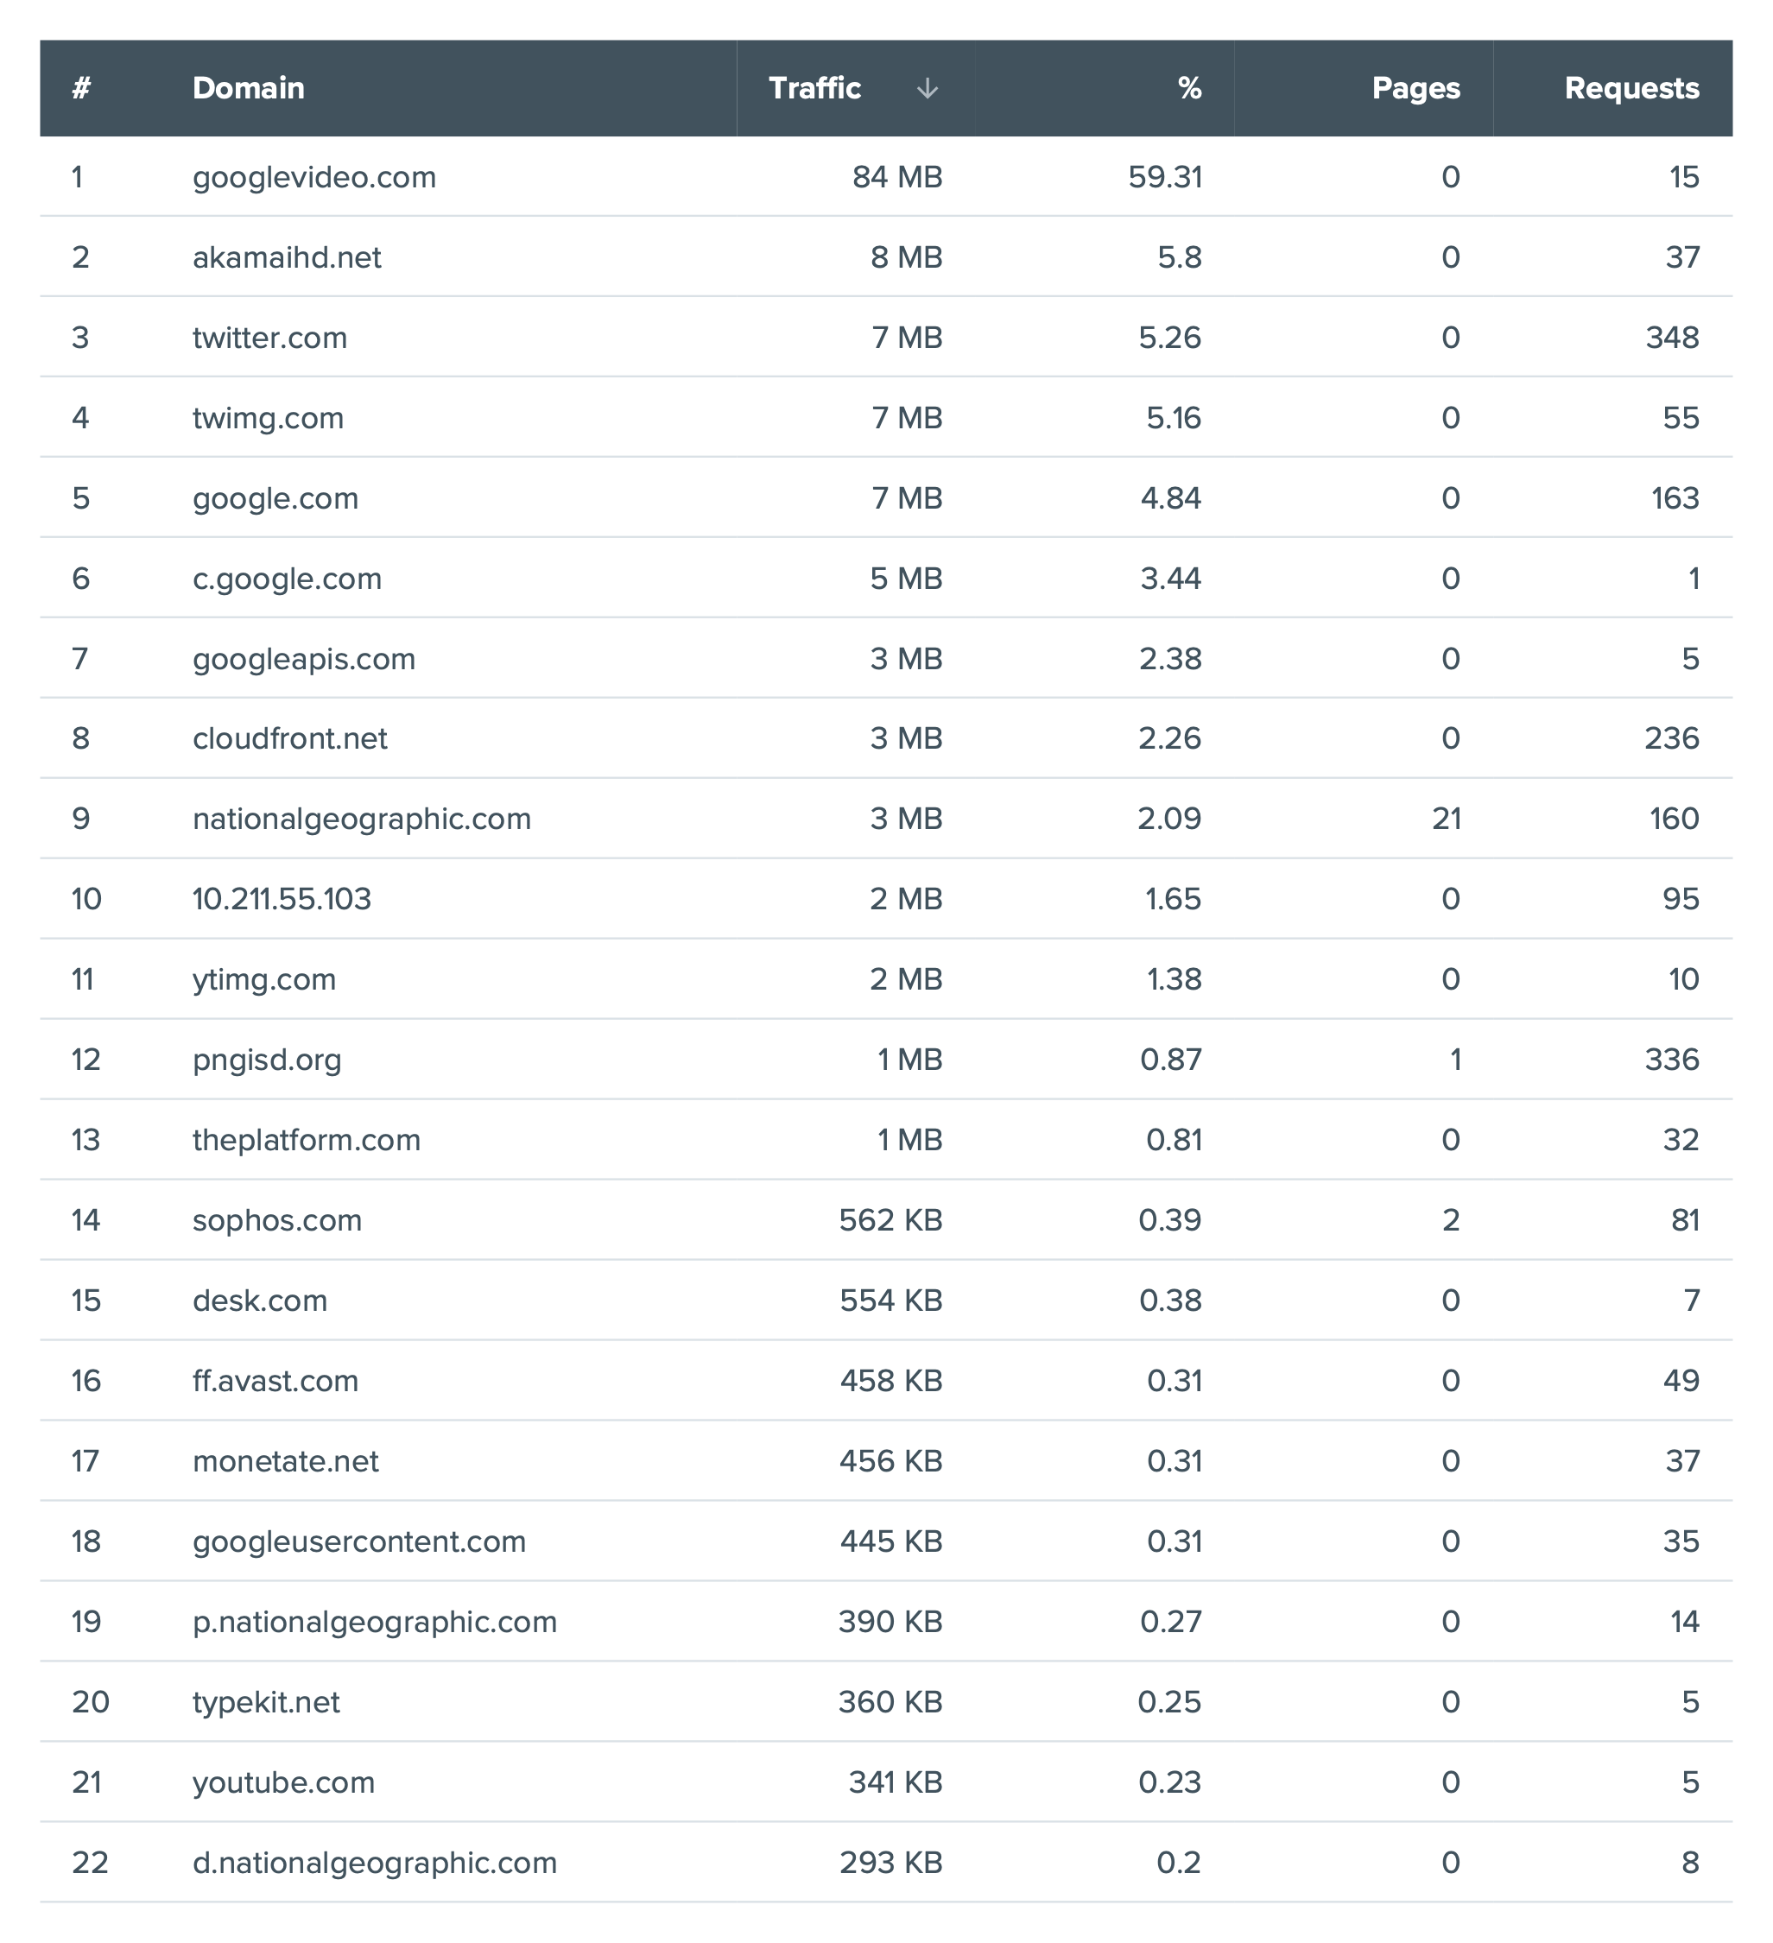
Which 2 sites
did I visit?
Notes:
This is a sample report created by a vendor-supplied reporting tool (e.g. FortiAnalyzer or Sophos iView), on a user’s traffic after visiting only two websites.
Can you tell which two websites the user actually visited in the browsing session?
The answer is National Geographic (listed at #9) and YouTube (listed at #21).
All the other sites reported by the firewall were not actually “visited” by the user, but were involved in delivering the content for the two sites that were typed into the browser.
If you sent this report to a non-technical person who wanted to know which sites a user had been browsing, would they find this information meaningful?

Slide 9
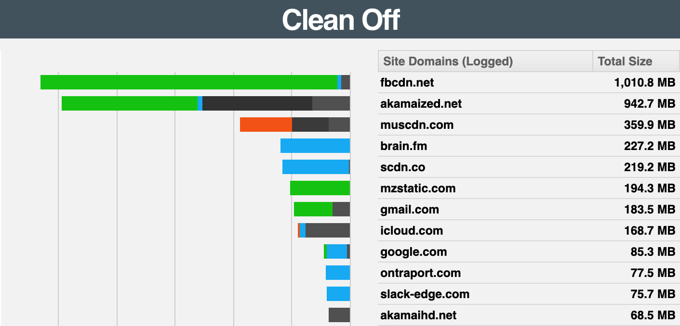
Introducing Site Clean
A unique technology that transforms log data to simplify and reflect the internet browsing behaviour of real people.
Notes:
Fastvue Site Clean, functionality developed by Fastvue and unique to our products, is included (for free) in each Fastvue Reporter license.
Demonstrated here, using real traffic examples, you can see the sites as logged by any firewall (Clean Off), and then the way that traffic is reported by Fastvue Reporter.
Site Clean makes sense of technical log data and makes it easy to understand for non-technical report readers.
In real-world terms, IT staff can schedule and publish reports for management and HR staff, and be confident that the reports will be readable, without having to explain the content.

Slide 10
Fastvue
Reporter
features
Notes:
Next we’ll have a look at some of the other key features of Fastvue Reporter.
[NB] You could switch to a walk-through of the software running in demo mode, or using real data, at this point in time, rather than using the following slides. Using the following slides allows you to highlight key features without the use of a software demo environment.

Slide 11

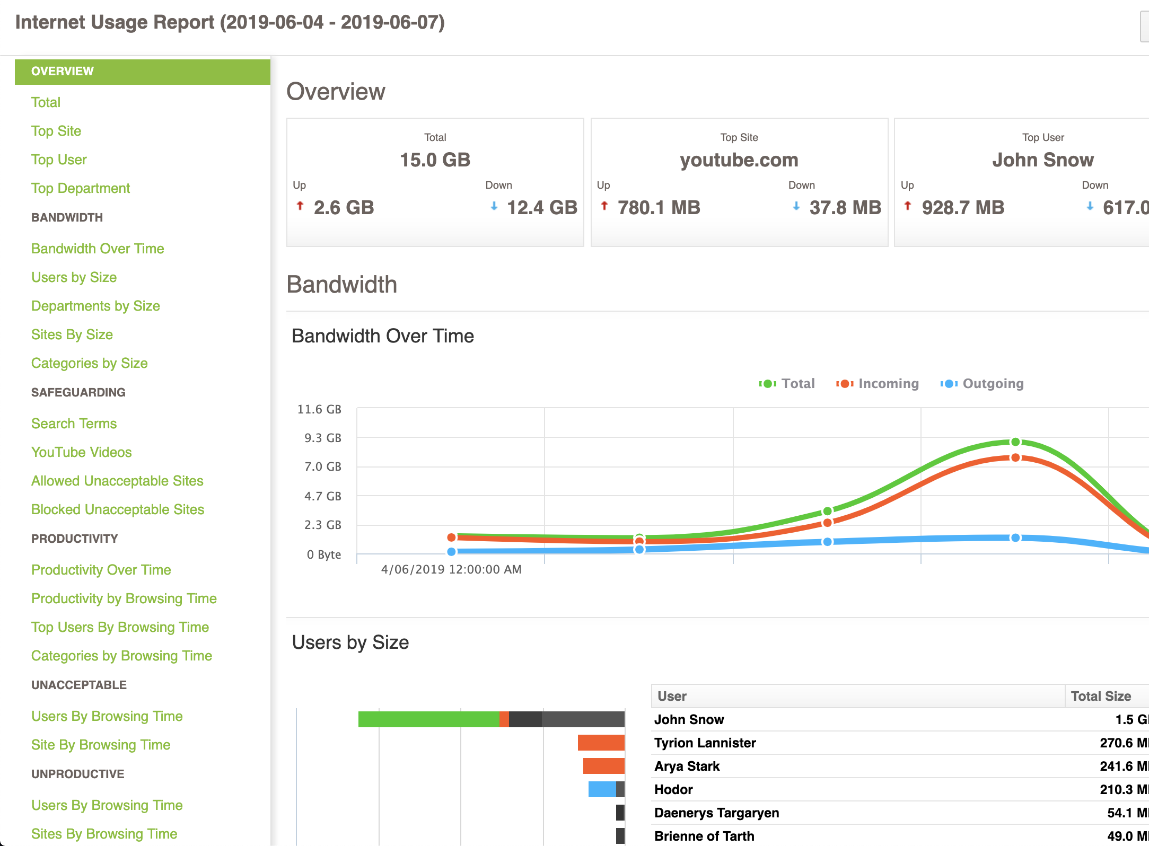
Intuitive reports
Well researched, pre-defined reports highlight exactly what non-technical audiences need to know.
Notes:
Fastvue Reporter is developed using over two decades of experience in the internet usage reporting space.
The software provides reports that contain the key information that readers need to know, delivered in well-designed layouts that make navigation to key information easy.

Slide 12

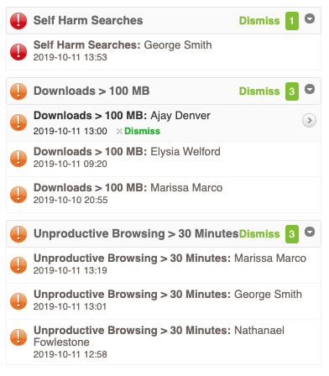
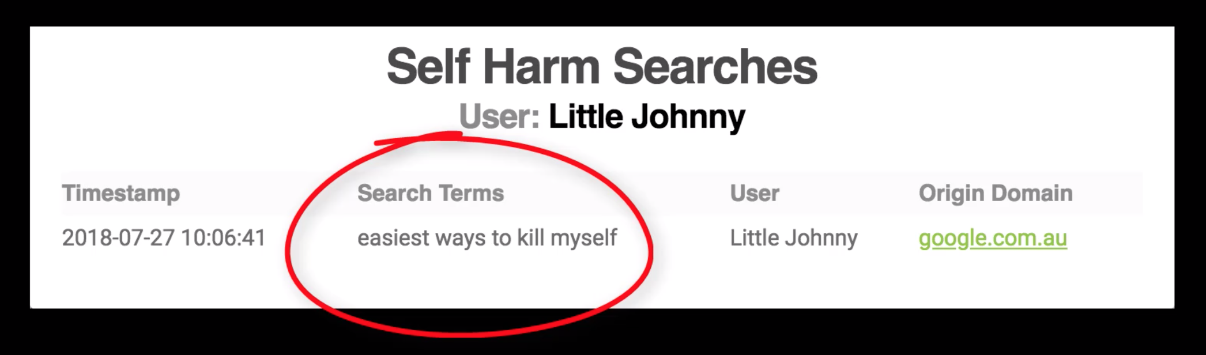
Stay alert
Don’t watch charts all day? Receive real-time alerts for important network concerns.
Notes:
As we mentioned earlier, real-time alerts can contain critical information that requires timely action.
Whether the alerts are on key issues such as self-harm or radicalisation, or on issues relating to productive and bandwidth hogging activity, Fastvue Reporter can give the right person access to this information in real-time.

Slide 13

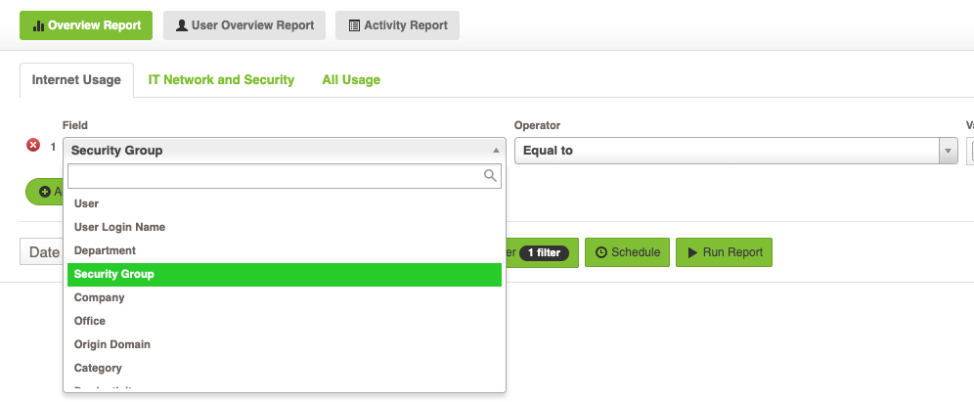
Department
Reports
Active Directory integration makes User and Department investigations a breeze.
Notes:
Fastvue Reporter automatically integrates with Active Directory to allow easy access to filter reports on various AD attributes in your organisation.

Slide 14

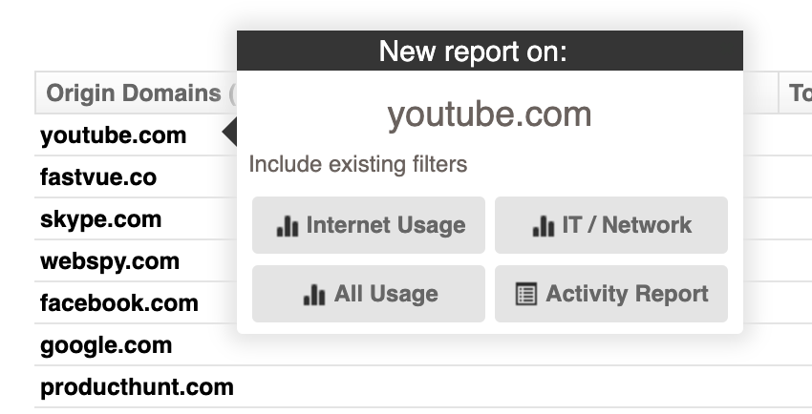
One click investigations
Click any item to run an investigation report, such as a user, site, application or web category.
Notes:
Find key information in the Dashboards or Reports and run secondary investigations and drill-downs to get more insights.

Slide 15

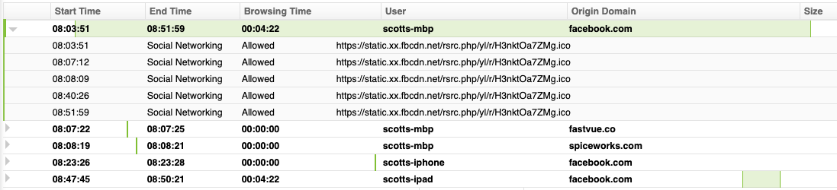
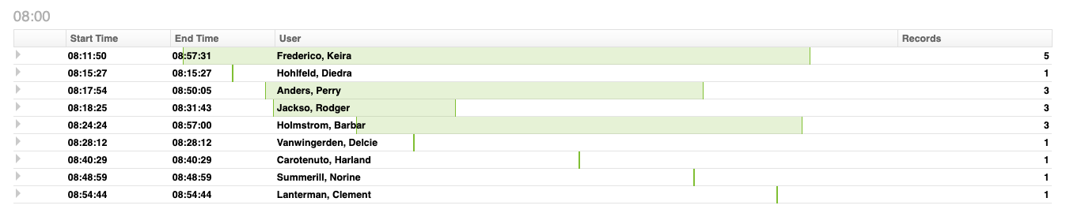
Activity reports
Full activity details, grouped by sessions, ordered by time.
Notes:
View information on browsing sessions and site visits in logical groupings, with additional information in expanding charts.
See browsing session times represented in easy to understand Gant charts.
Do you need to see a list of all users who have accessed a particular site, in chronological order, and see how long each user was on the site? Easy.

Slide 16
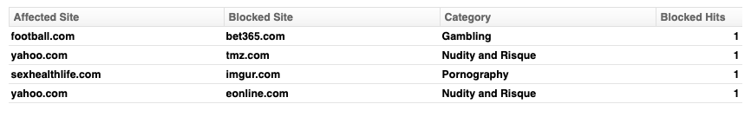
Avoid awkward
conversations
Was a user really trying to go to a blocked website?
Notes:
Fastvue Reporter’s Site Clean functionality goes beyond just making reports easy to read.
Here we see an example of a common problem with firewall reports. The firewall most likely reported that it stopped a user from browsing to unacceptable content. But was the user really trying to access that content?
It is very common for legitimate websites (those listed in the Affected Site column) to deliver ads or linked content from external sources (those listed in the Blocked Site column).
Using Fastvue Reporter you can easily distinguish between sites a users was browsing and blocked content coming from an external source linked to that site.

Slide 17

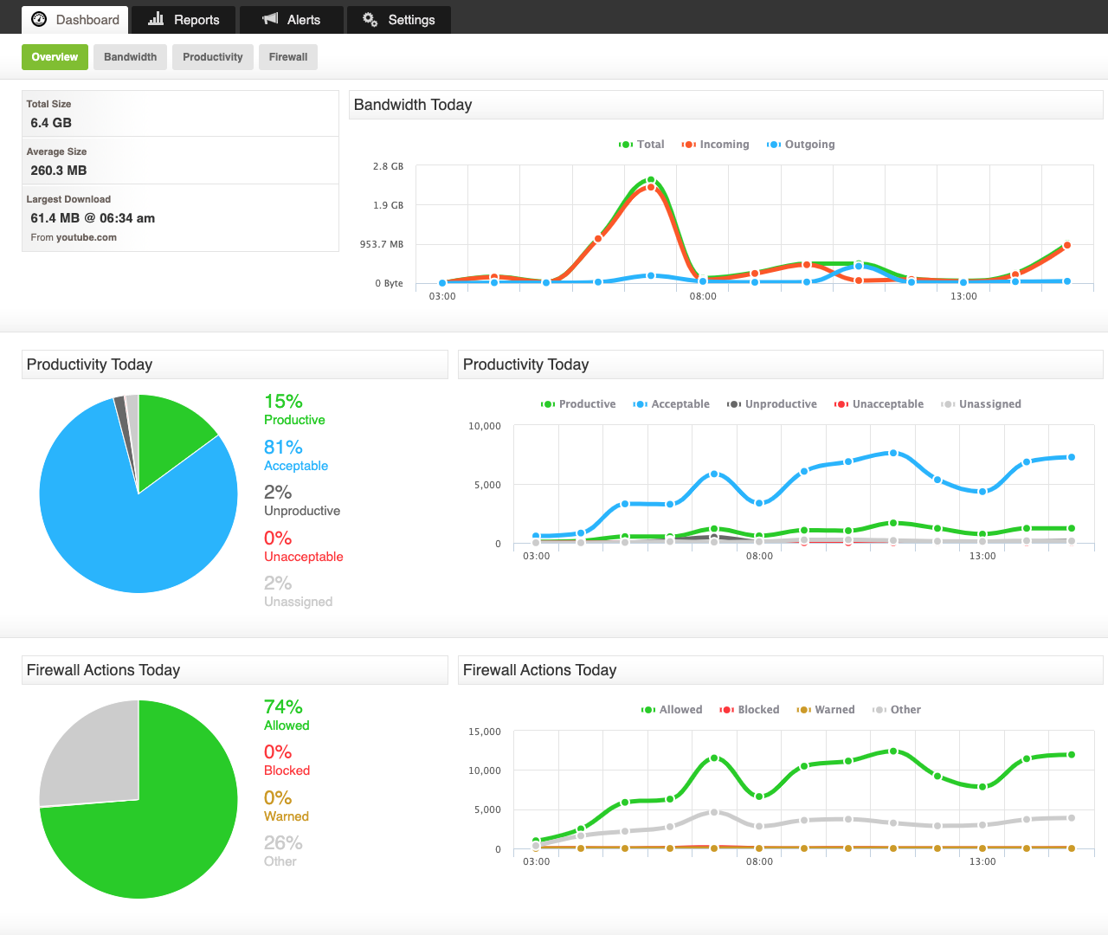
Real time dashboards
Real Time Dashboards are always ready to tell you what is happening on your network right now.
Notes:
Fastvue Reporter offers a variety of real-time dashboards on Bandwidth, Productivity and Firewall information.
Are you getting complaints of slow internet? What (or who) might be hogging the bandwidth?
Would you like to know whether the internet usage is work related or time-wasting or potentially harmful browsing?

Slide 18

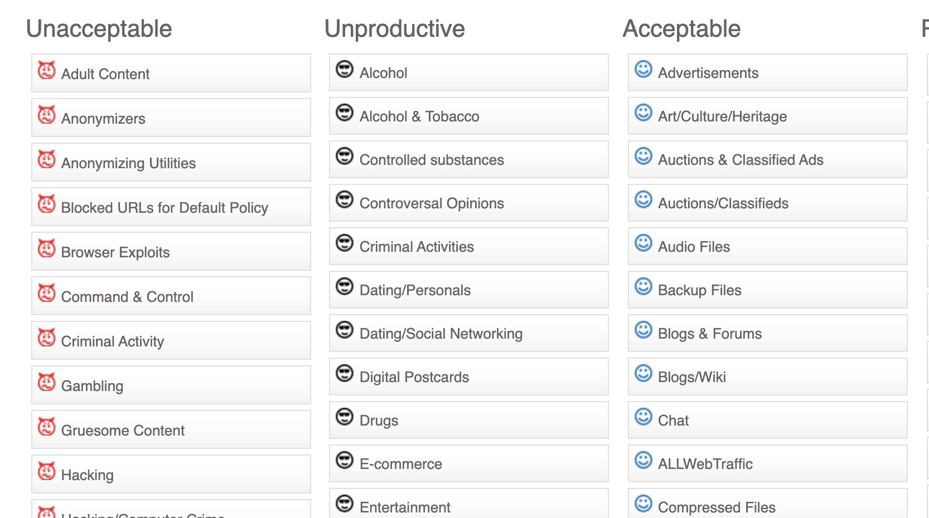
What is unproductive?
Use your firewall’s URL Filtering Categories to customize the productivity assessment for your organization
Notes:
You’ve probably seen reference to Productivity throughout this presentation and would like to know how Fastvue Reporter handles that information.
Fastvue recognises the categorisation being done by your firewall. The various categories, some of which are listed here, are then grouped into buckets such as Unacceptable and Acceptable etc.
If you disagree with where a category has been place, you simply drag and drop it into a most appropriate group to match your needs. Future reports and dashboards will reflect the changes.

Slide 19

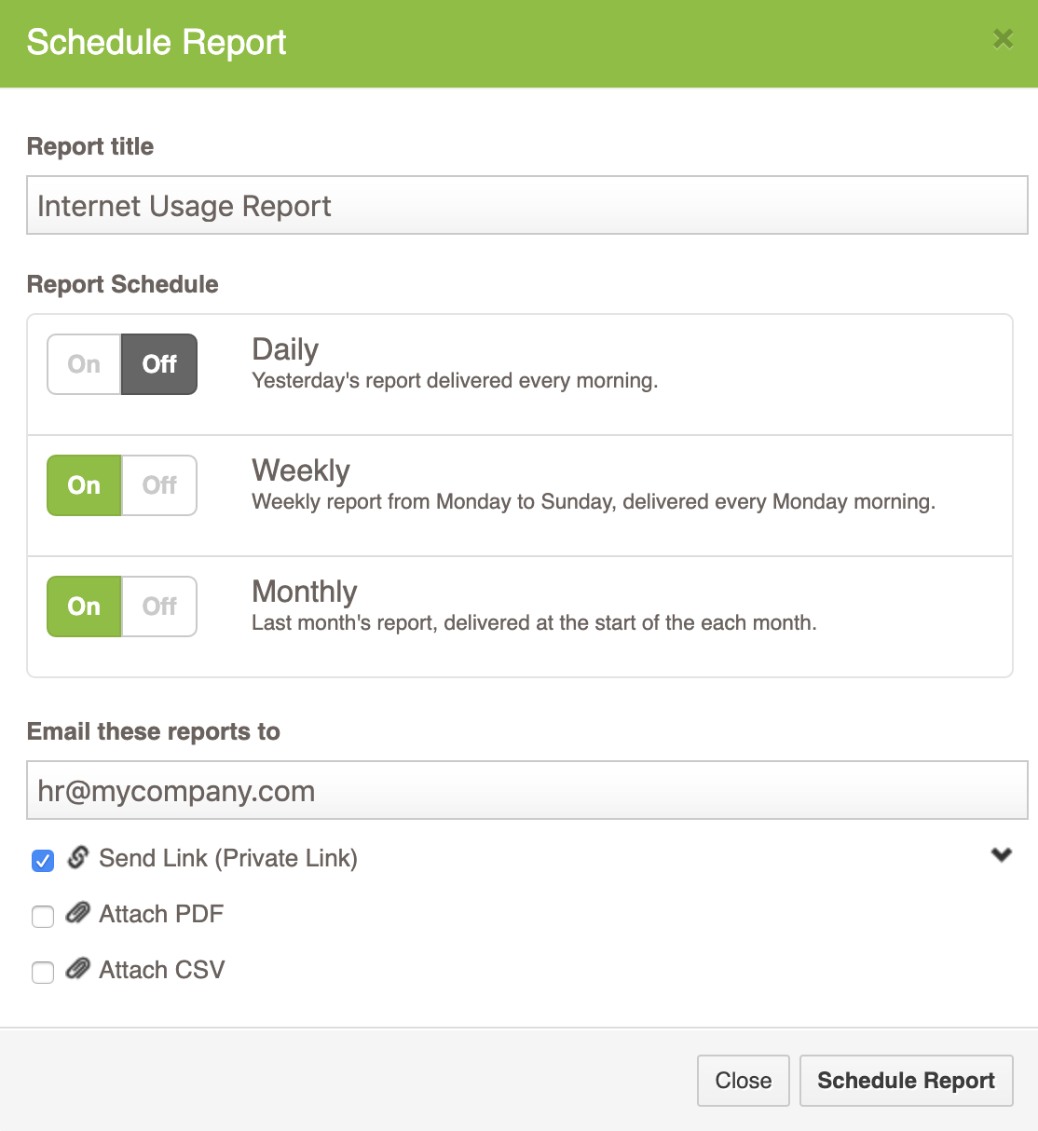
Inbox delivery
Reports delivered to your inbox each day, week or month.
Notes:
Fastvue Reporter offers flexible scheduling options and integration with email to send reports to the right people.
Running scheduled reports will enable a proactive approach to internet usage reporting.
Reporting on users that are suspected of inappropriate activity is likely to miss a lot of misuse.
Using scheduled reports will take internet usage reporting off the task list of IT staff, and send the information to HR and Department Managers, who are responsible for addressing such matters.

Slide 20
How does Fastvue work
Imports Syslog
Enable Content Filtering & HTTPS Inspection
Installation On-Premises or Private Cloud, Windows or Linux Server
Notes:
Fastvue Reporter consumes the Syslog data sent by your firewall(s)
It requires Content Filtering and HTTPS Inspection / Deep Packet Inspection enabled on your firewall.
DPI is required for Search Term and Video reports, as well as getting the most out of the Fastvue Site Clean functionality.
Install on a Windows or Linux Server (Linux supported via Docker), on-prem or private cloud.

Slide 21
Any
questions?

